Slide 1
TESTING CONVENTIONAL AND OBJECT-ORIENTED
APPLICATIONS
Session 16
Course : Software Engineering
Effective Period : Desember 2017

Slide 2
These slides have been adapted from
Pressman, R.S. (2015). Software Engineering : A Practioner's Approach. 8th ed. McGraw-Hill Companies.Inc, Americas, New York. ISBN : 978 1 259 253157. Chapter 23 and 24
Acknowledgement

Slide 3
Learning Objectives
LO 3 : Demonstrate the software quality assurances

Slide 4
Contents
Software Testing Fundamentals
Internal and External Views of Testing
White Box Testing
Basis Path Testing
Control Structure Testing
Black Box Testing
Model Based Testing
Software Testing Patterns
Testing OOA and OOD Models
OOTesting Strategies
OOTesting Methods

Slide 5
Software Testing Fundamentals
Testability
Operability —it operates cleanly
Observability —the results of each test case are readily observed
Controllability —the degree to which testing can be automated and optimized
Decomposability —testing can be targeted
Simplicity —reduce complex architecture and logic to simplify tests
Stability —few changes are requested during testing
Understandability —of the design

Slide 6
Software Testing Fundamentals
What is a “Good” Test?
A good test has a high probability of finding an error
A good test is not redundant.
A good test should be “best of breed”
A good test should be neither too simple nor too complex

Slide 7
Internal and External Views of Testing
Any engineered product (and most other things) can be tested in one of two ways:
  Knowing the specified function that a product has been designed to perform, tests can be conducted that demonstrate each function is fully operational while at the same time searching for errors in each function;
  Knowing the internal workings of a product, tests can be conducted to ensure that "all gears mesh," that is, internal operations are performed according to specifications and all internal components have been adequately exercised.

Slide 8
Internal and External Views of Testing
Exhaustive Testing
loop < 20 X
14
There are 10 possible paths! If we execute one
test per millisecond, it would take 3,170 years to
test this program!!

Slide 9
Internal and External
Views of Testing
Selective Testing
Selected path
loop < 20 X

Slide 10
Internal and External
Views of Testing
Software Testing
white-box
methods
black-box
methods
Methods
Strategies

Slide 11

White-Box Testing
... our goal is to ensure that all
statements and conditions have
been executed at least once ...

Slide 12
White-Box Testing
Why Cover?
logic errors and incorrect assumptions
are inversely proportional to a path's
execution probability
we often
believe
that a path is not
likely to be executed; in fact, reality is
often counter intuitive
typographical errors are random; it's
likely that untested paths will contain
some

Slide 13
Basis Path Testing
First, we compute the cyclomatic
complexity:
number of simple decisions + 1
or
number of enclosed areas + 1
In this case, V(G) = 4

Slide 14
Basis Path Testing
Cyclomatic Complexity
A number of industry studies have indicated
that the higher V(G), the higher the probability
or errors.
modules
V(G)
modules in this range are
more error prone

Slide 15
Basis Path Testing
1
Next, we derive the
independent paths:
2
Since V(G) = 4,
there are four paths
3
Path 1: 1,2,3,6,7,8
4
Path 2: 1,2,3,5,7,8
5
6
Path 3: 1,2,4,7,8
Path 4: 1,2,4,7,2,4,...7,8
Finally, we derive test
7
cases to exercise these
paths.
8

Slide 16
Basis Path Testing
Basis Path Testing Notes
you don't need a flow chart,
but the picture will help when
you trace program paths
count each simple logical test,
compound tests count as 2 or
more
basis path testing should be
applied to critical modules

Slide 17
Basis Path Testing
Deriving Test Cases
Summarizing:
  Using the design or code as a foundation, draw a corresponding flow graph.
  Determine the cyclomatic complexity of the resultant flow graph.
  Determine a basis set of linearly independent paths.
  Prepare test cases that will force execution of each path in the basis set.

Slide 18
Basis Path Testing
Graph Matrices
A graph matrix is a square matrix whose size (i.e., number of rows and columns) is equal to the number of nodes on a flow graph
Each row and column corresponds to an identified node, and matrix entries correspond to connections (an edge) between nodes.
By adding a link weight to each matrix entry, the graph matrix can become a powerful tool for evaluating program control structure during testing

Slide 19
Control Structure Testing
Condition testing — a test case design method that exercises the logical conditions contained in a program module
Data flow testing — selects test paths of a program according to the locations of definitions and uses of variables in the program

Slide 20
Control Structure Testing
Loop Testing
Simple
loop
Nested
Loops
Concatenated
Loops
Unstructured
Loops

Slide 21
Black-Box Testing
requirements
output
input
events

Slide 22
Black-Box Testing
How is functional validity tested?
How is system behavior and performance tested?
What classes of input will make good test cases?
Is the system particularly sensitive to certain input values?
How are the boundaries of a data class isolated?
What data rates and data volume can the system tolerate?
What effect will specific combinations of data have on system operation?

Slide 23
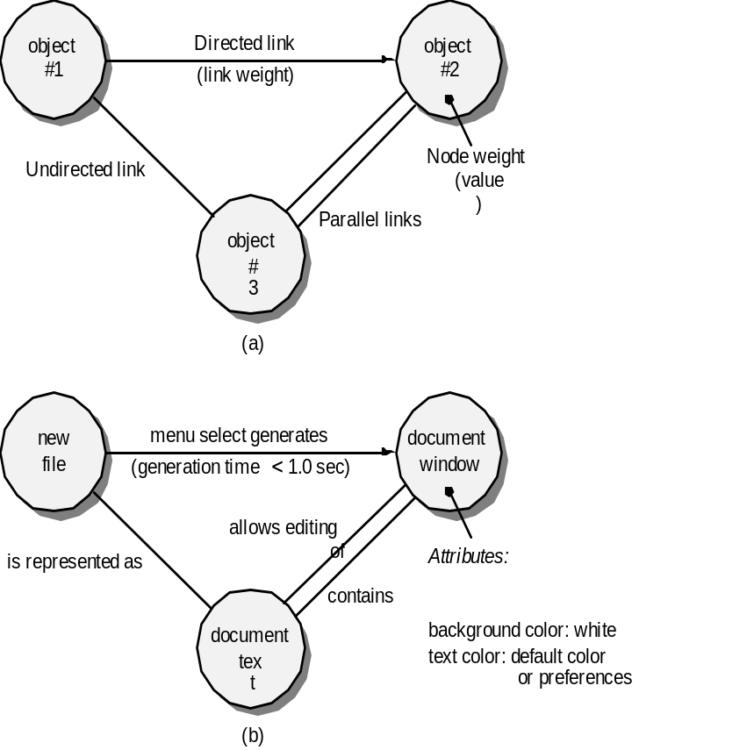
Black-Box Testing
Graph-Based Methods
To understand the objects that are modeled in software and the relationships that connect these objects
In this context, we consider the term “objects” in the broadest possible context. It encompasses data objects, traditional components (modules), and object-oriented elements of computer software.

Slide 24
Black-Box Testing
Comparison Testing
Used only in situations in which the reliability of software is absolutely critical (e.g., human-rated systems)
  Separate software engineering teams develop independent versions of an application using the same specification
  Each version can be tested with the same test data to ensure that all provide identical output
  Then all versions are executed in parallel with real-time comparison of results to ensure consistency

Slide 25
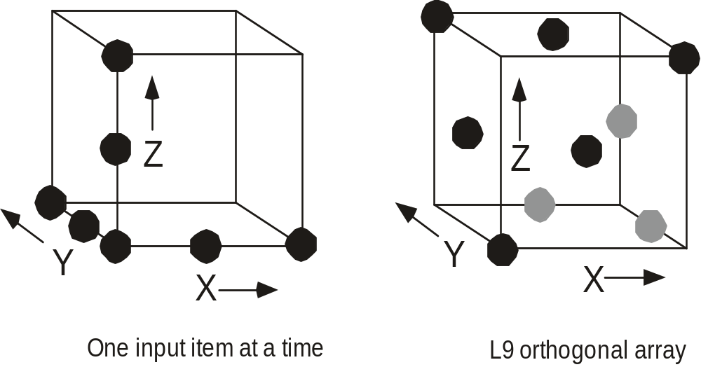
Black-Box Testing
Orthogonal Array Testing
Used when the number of input parameters is small and the values that each of the parameters may take are clearly bounded

Slide 26
Model-Based Testing
Analyze an existing behavioral model for the software or create one.
  Recall that a behavioral model indicates how software will respond to external events or stimuli.
Traverse the behavioral model and specify the inputs that will force the software to make the transition from state to state.
  The inputs will trigger events that will cause the transition to occur.
Review the behavioral model and note the expected outputs as the software makes the transition from state to state.
Execute the test cases.
Compare actual and expected results and take corrective action as required.

Slide 27
Software Testing Patterns
Testing patterns are described in much the same way as design patterns
Example:
    Pattern name: ScenarioTesting
    Abstract: Once unit and integration tests have been conducted, there is a need to determine whether the software will perform in a manner that satisfies users. The ScenarioTesting pattern describes a technique for exercising the software from the user’s point of view. A failure at this level indicates that the software has failed to meet a user visible requirement. [Kan01]

Slide 28
Testing OOA and OOD Models
To adequately test OO systems, three things must be done:
  the definition of testing must be broadened to include error discovery techniques applied to object-oriented analysis and design models
  the strategy for unit and integration testing must change significantly, and
  the design of test cases must account for the unique characteristics of OO software.

Slide 29
Testing OOA and OOD Models
‘Testing’ OO Models
The review of OO analysis and design models is especially useful because the same semantic constructs (e.g., classes, attributes, operations, messages) appear at the analysis, design, and code level
Therefore, a problem in the definition of class attributes that is uncovered during analysis will circumvent side affects that might occur if the problem were not discovered until design or code (or even the next iteration of analysis).

Slide 30
Testing OOA and OOD Models
Correctness of OO Models
During analysis and design, semantic correctness can be asesssed based on the model’s conformance to the real world problem domain.
If the model accurately reflects the real world (to a level of detail that is appropriate to the stage of development at which the model is reviewed) then it is semantically correct.
To determine whether the model does, in fact, reflect real world requirements, it should be presented to problem domain experts who will examine the class definitions and hierarchy for omissions and ambiguity.
Class relationships (instance connections) are evaluated to determine whether they accurately reflect real-world object connections.

Slide 31
Testing OOA and OOD Models
Class Model Consistency
Revisit the CRC model and the object-relationship model.
Inspect the description of each CRC index card to determine if a delegated responsibility is part of the collaborator’s definition.
Invert the connection to ensure that each collaborator that is asked for service is receiving requests from a reasonable source.
Using the inverted connections examined in the preceding step, determine whether other classes might be required or whether responsibilities are properly grouped among the classes.
Determine whether widely requested responsibilities might be combined into a single responsibility.

Slide 32
OO Testing Strategies
Unit testing
  the concept of the unit changes
  the smallest testable unit is the encapsulated class
  a single operation can no longer be tested in isolation (the conventional view of unit testing) but rather, as part of a class
Integration Testing
  Thread-based testing integrates the set of classes required to respond to one input or event for the system
  Use-based testing begins the construction of the system by testing those classes (called independent classes) that use very few (if any) of server classes. After the independent classes are tested, the next layer of classes, called dependent classes
  Cluster testing defines a cluster of collaborating classes (determined by examining the CRC and object-relationship model) is exercised by designing test cases that attempt to uncover errors in the collaborations.

Slide 33
OO Testing Strategies
Validation Testing
  details of class connections disappear
  draw upon use cases that are part of the requirements model
  Conventional black-box testing methods can be used to drive validation tests

Slide 34
OOT Methods
Berard [Ber93] proposes the following approach:
Each test case should be uniquely identified and should be explicitly associated with the class to be tested
The purpose of the test should be stated.
A list of testing steps should be developed for each test and should contain:
  a list of specified states for the object that is to be tested
  a list of messages and operations that will be exercised as a on sequence of the test
  a list of exceptions that may occur as the object is tested
  a list of external conditions (i.e., changes in the environment external to the software that must exist in order to properly conduct the test)\
  supplementary information that will aid in understanding or implementing the test.

Slide 35
OOT Methods
Fault-based testing
  The tester looks for plausible faults (i.e., aspects of the implementation of the system that may result in defects). To determine whether these faults exist, test cases are designed to exercise the design or code.
Class Testing and the Class Hierarchy
  Inheritance does not obviate the need for thorough testing of all derived classes. In fact, it can actually complicate the testing process.
Scenario-Based Test Design
  Scenario-based testing concentrates on what the user does, not what the product does. This means capturing the tasks (via use-cases) that the user has to perform, then applying them and their variants as tests.

Slide 36
OOT Methods
Random Testing
Random testing
  identify operations applicable to a class
  define constraints on their use
  identify a minimum test sequence
    an operation sequence that defines the minimum life history of the class (object)
  generate a variety of random (but valid) test sequences
    exercise other (more complex) class instance life histories

Slide 37
OOT Methods
Partition Testing
Partition Testing
  reduces the number of test cases required to test a class in much the same way as equivalence partitioning for conventional software
  state-based partitioning
    categorize and test operations based on their ability to change the state of a class
  attribute-based partitioning
    categorize and test operations based on the attributes that they use
  category-based partitioning
    categorize and test operations based on the generic function each performs

Slide 38
OOT Methods
Inter-Class Testing
Inter-class testing
  For each client class, use the list of class operators to generate a series of random test sequences. The operators will send messages to other server classes.
  For each message that is generated, determine the collaborator class and the corresponding operator in the server object.
  For each operator in the server object (that has been invoked by messages sent from the client object), determine the messages that it transmits.
  For each of the messages, determine the next level of operators that are invoked and incorporate these into the test sequence

Slide 39
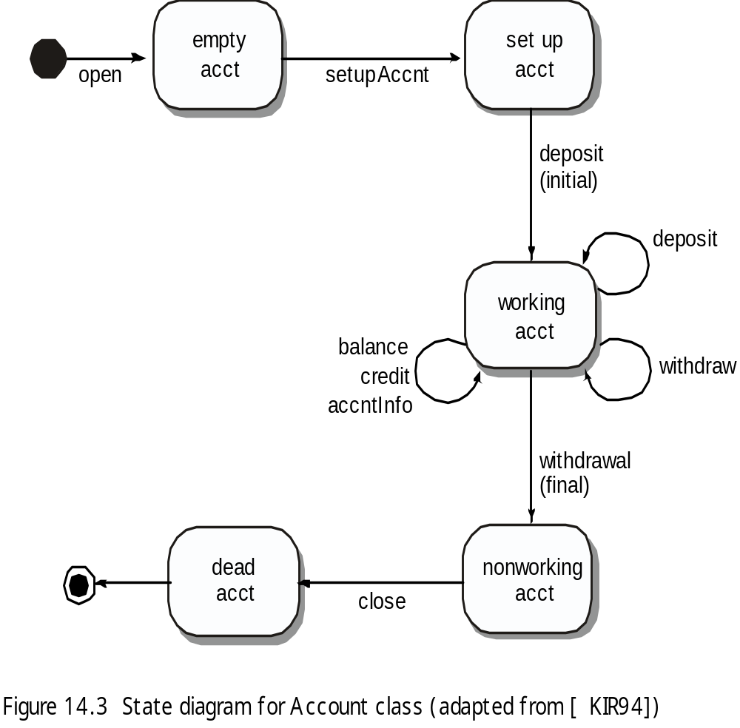
OOT Methods
Behavior Testing
The tests to be designed should achieve all state coverage [KIR94].
That is, the operation sequences should cause the account class to make transition through all allowable states

Slide 40
References
Pressman, R.S. (2015). Software Engineering : A Practioner's Approach. 8th ed. McGraw-Hill Companies.Inc, Americas, New York. ISBN : 978 1 259 253157.
Software Testing, http://www.io.com/~wazmo/qa/
SW Testing Storm, http://www.mtsu.edu/~storm ‎
Conventional sw testing, http://www.testingexcellence.com/conventional-software-testing-on-an-extreme-programming-team/

Slide 41
Q & A

